Slide 1
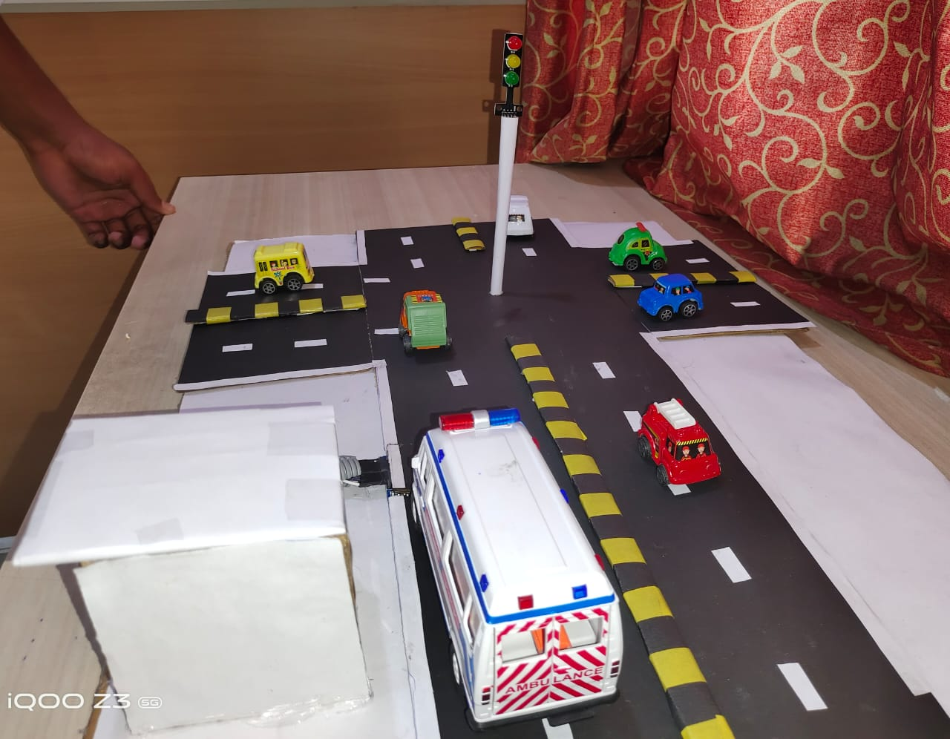
Traffic priority for ambulance
M.Vasanth Reddy

Slide 2
PROBLEM STATEMENT :
Most of the emergency hospital ambulances are equipped with paramedics, even though they are unable to reach the incident site because of huge traffic at junctions. Once the ambulance got struck in traffic, it takes more time to reach the incident and it is obvious what happens to the patient till the ambulance reaches? Due to slow movement of traffic the ambulance cannot reach the hospital at right time and leads to death of the patient.
SOLUTION:
Developing a working detector model for emergency vehicle detection in traffic signals, which will detect the vehicle and the signal at the junction comes to green and allow the traffic to flow in that direction, after the vehicles moves the signal at that point will works as usual.

Slide 3
ABSTRACT:
Traffic is the most critical problem in metropolitan cities.
Traffic control becomes more necessary to provide problem-less, peaceful driving and pollution-less life to people.
There is a need for implementing an effective traffic control systems to avoid heavy traffic congestion.
Make a better solution for emergency vehicle traffic clearance.
The signal timing changes automatically on sensing the emergency vehicle.
The Arduino Uno controller & RFID-RC522 are used for instructing the LED to glow.
The whole system when installed on road, provides a way for easy traffic clearance for emergency vehicles without a need of sergeant.

Slide 4
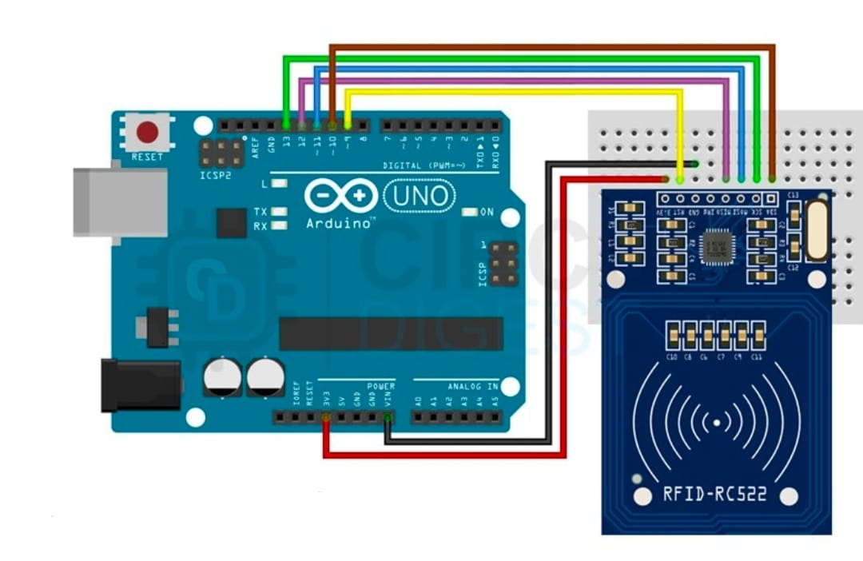
DIAGRAM :

Slide 5
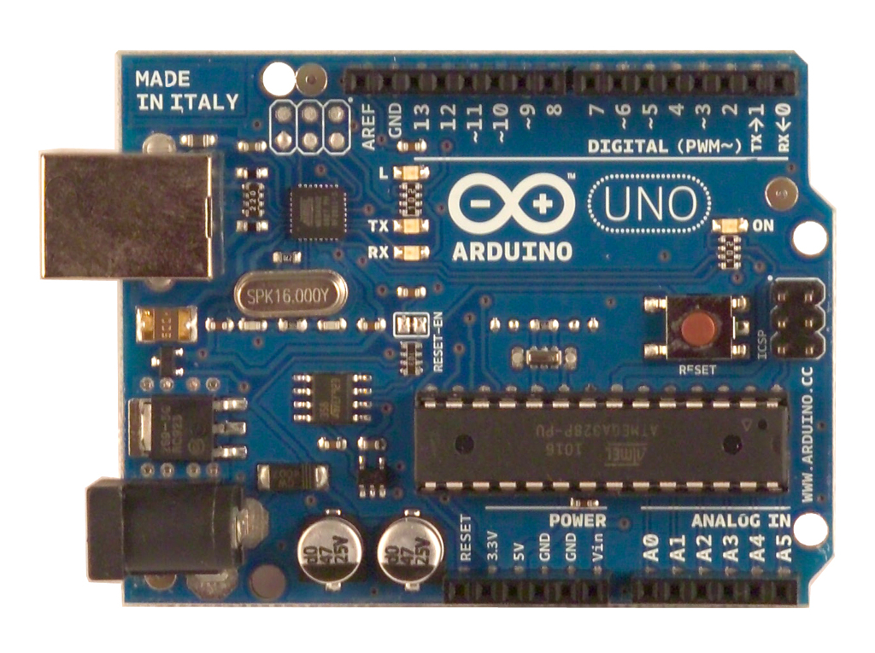
CIRCUIT COMPONENTS :
Arduino Uno

Slide 6
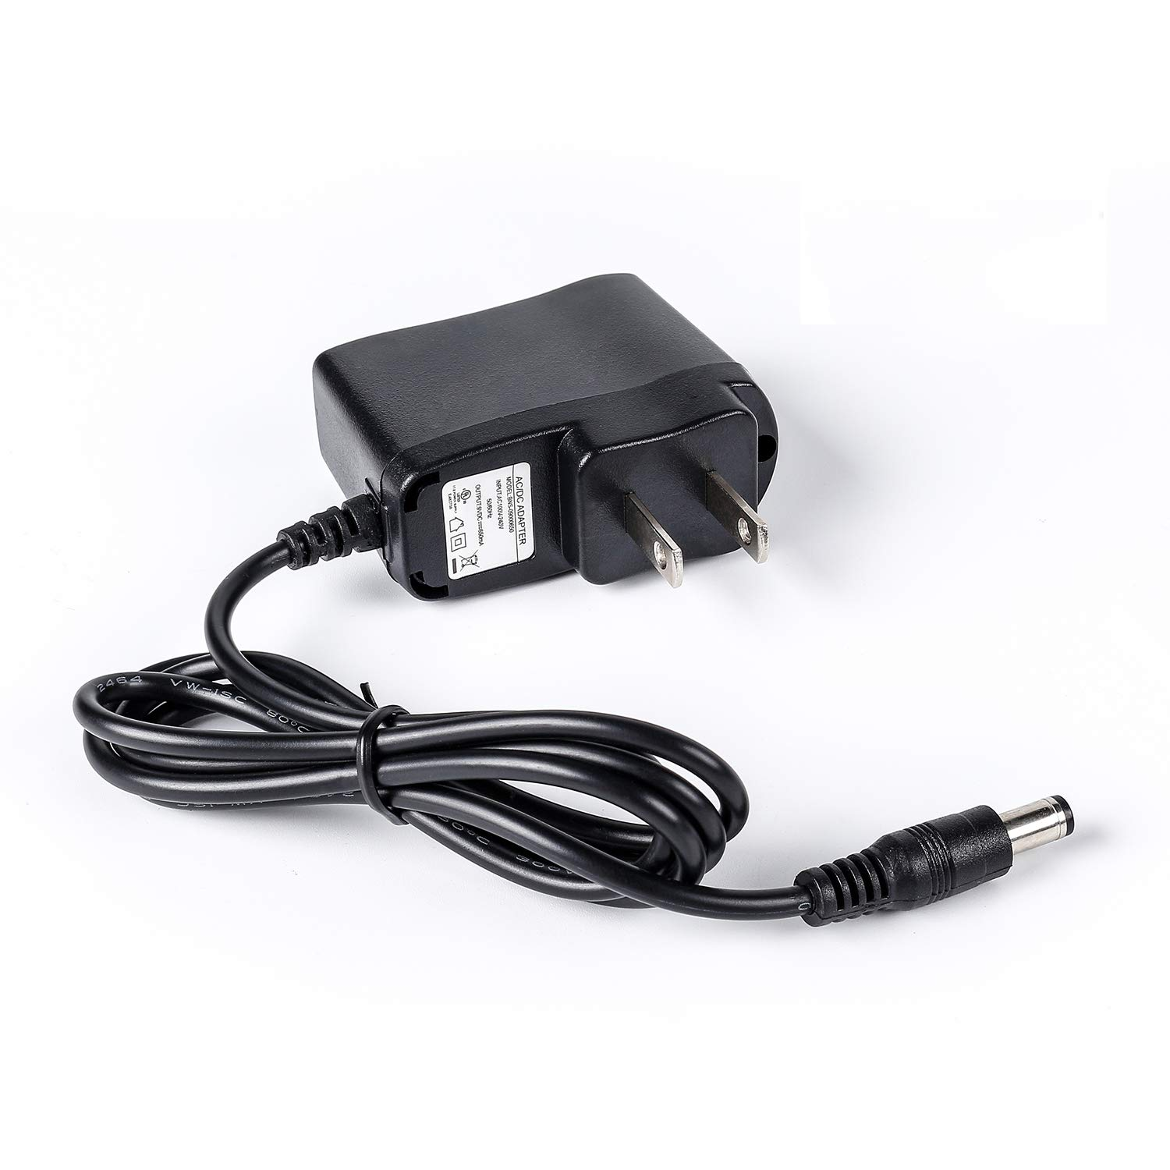
12v adapter for Arduino:

Slide 7
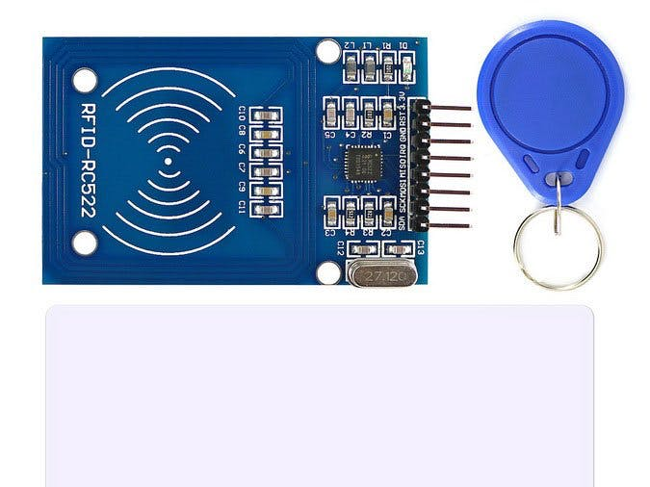
RFID - RC522

Slide 8
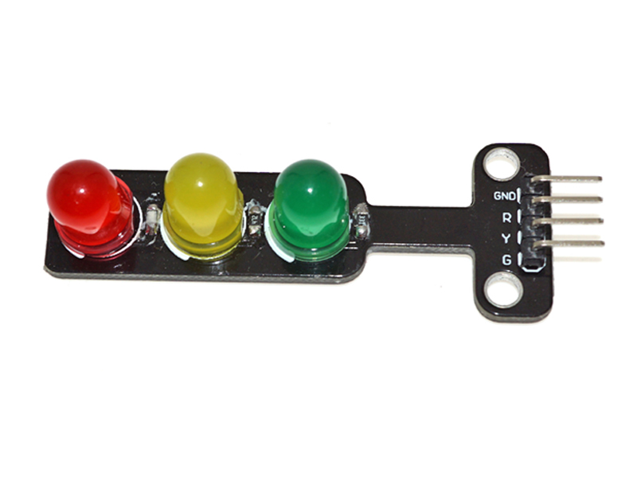
LED traffic lights

Slide 9
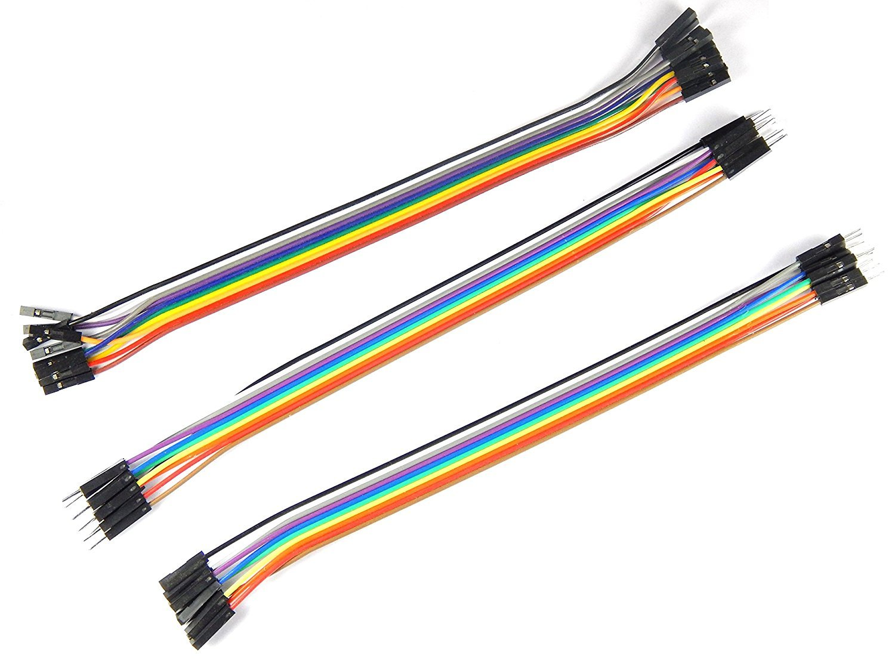
Jumper wires

Slide 10
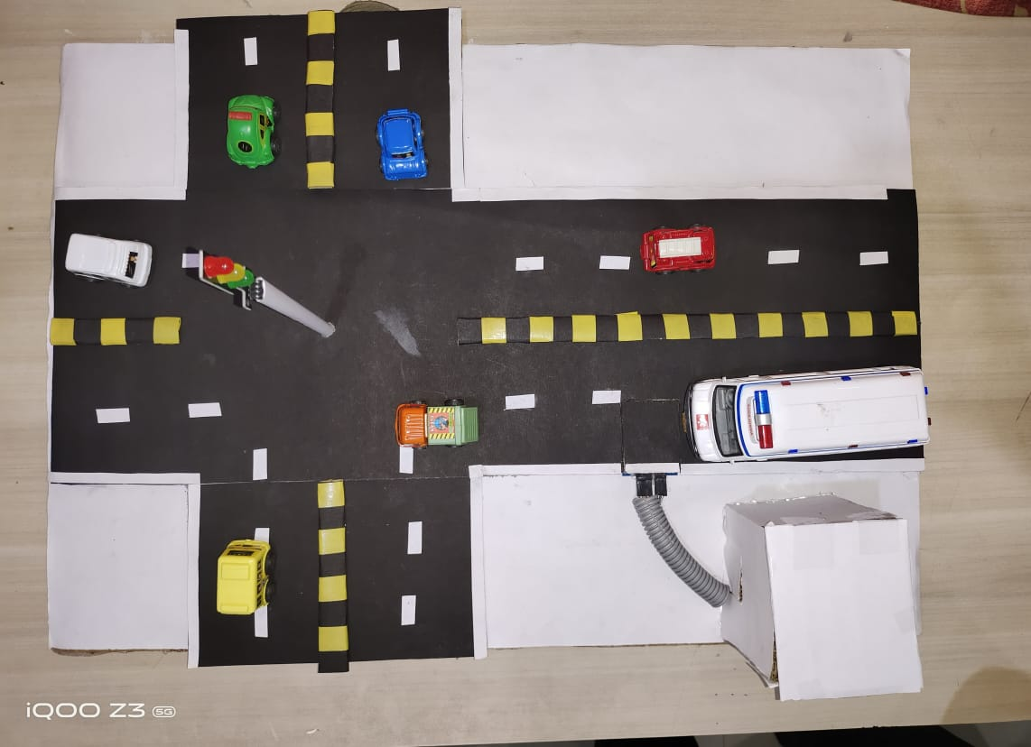
PROTOTYPE :

Slide 11
FUTURE SCOPE :
This system can be adopted for any real time Emergency vehicles, helps to save the human lives.
In order to achieve traffic control to provide clearance for any emergency vehicles and to shorten its time taken to reach the hospital.
With the help of google maps it is very easy to detect and find the shortest path of any emergency vehicle
As this system is easy to implement and cost involved is also less, this system can adopted for traffic clearance for any emergency vehicles in urban areas.
This project can be used as the part of Intelligent Transport System in smart city project.

Slide 12
CONCLUSION :
An idea is proposed in this project for controlling the traffic signals in favour of emergency vehicles and regulating time intervals based on situation. With this system the vehicles can be cleared from traffic efficiently by reducing waiting time lost in red lights, through fixing time intervals, which are determined automatically by the system, allowing easy transit for vehicles. This system also allows Emergency Vehicles to be man euvered from the Traffic Junction without major loss of time and hence improving the chances of survival of victims in the Point of Emergency. This system is an entry level idea to develop Smart Traffic Signals which can respond to traffic intervals based on movement of vehicles in traffic and also mange free transit of Emergency vehicles. This system in the future can be Implemented with additional features that will aid to further improve the flow of traffic in cities combating the problems that arise due to traffic congestion.

Slide 13
THANK YOU

